Slide 1
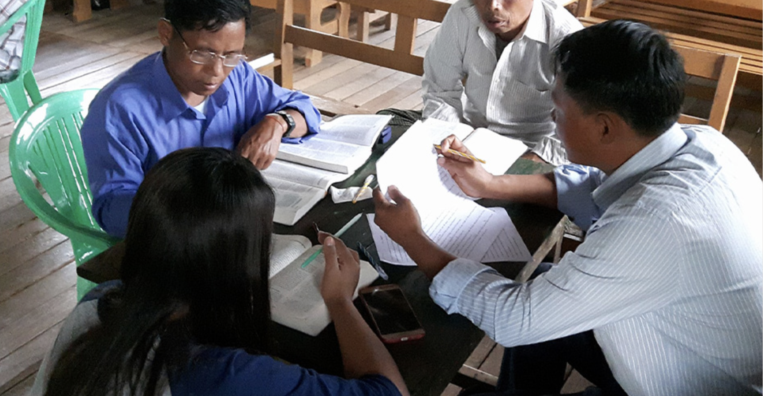
MAST Checking Steps

Slide 2
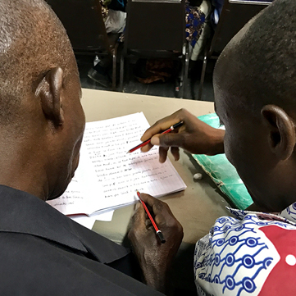

The 8 Steps of MAST
Drafting Steps
Checking Steps
Consume
Verbalize
Chunk
Blind Draft
Self-edit
Peer-edit
Key Word Check
Verse-by-Verse Check

Slide 3
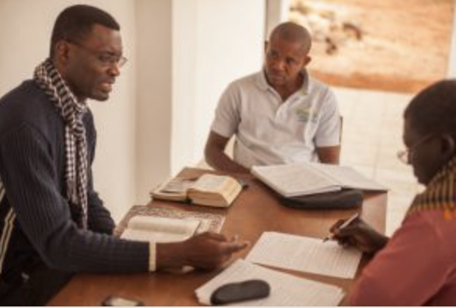
Checking Steps Defined
5
6
7
8
Self-edit
Peer-edit
Key Word Check
Verse-by-Verse Check
Compare each chunk to source; make any edits
Another translator compares and suggests edits
Work with a partner to ensure that the key words are clear
Translator reads each verse of translation aloud
Checker 1, out loud, translates each verse back into the source language
Checker 2 listens and looks at source text to compare

Slide 4
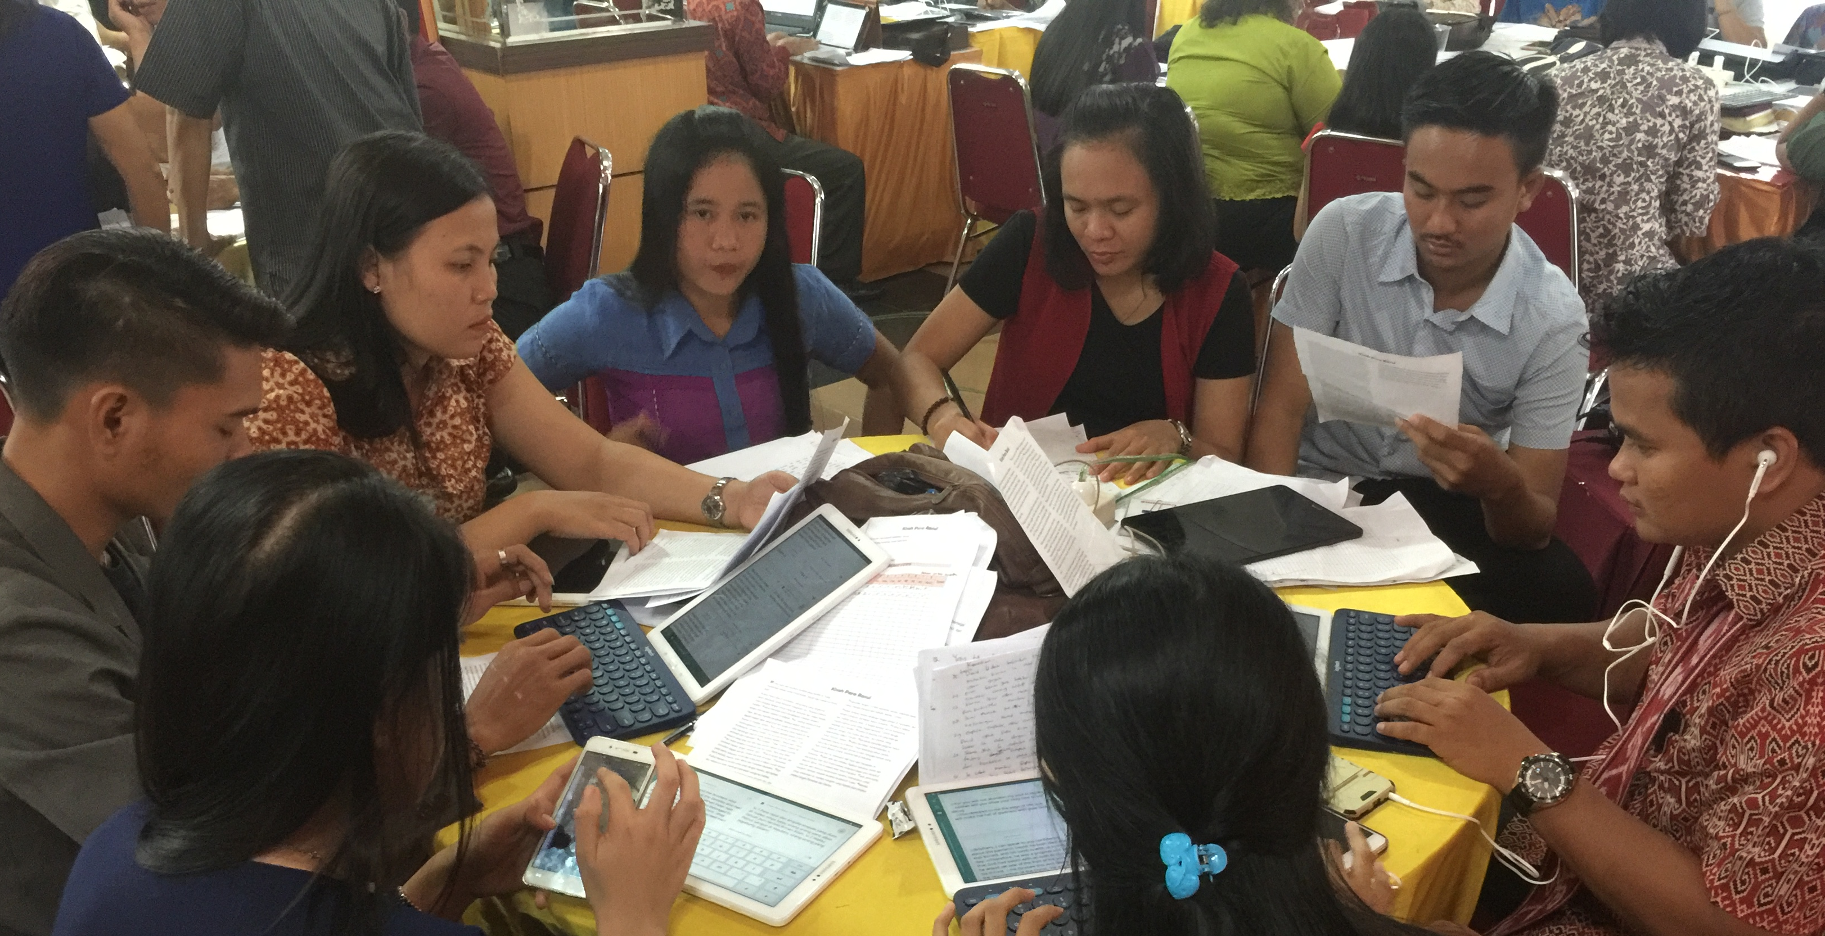
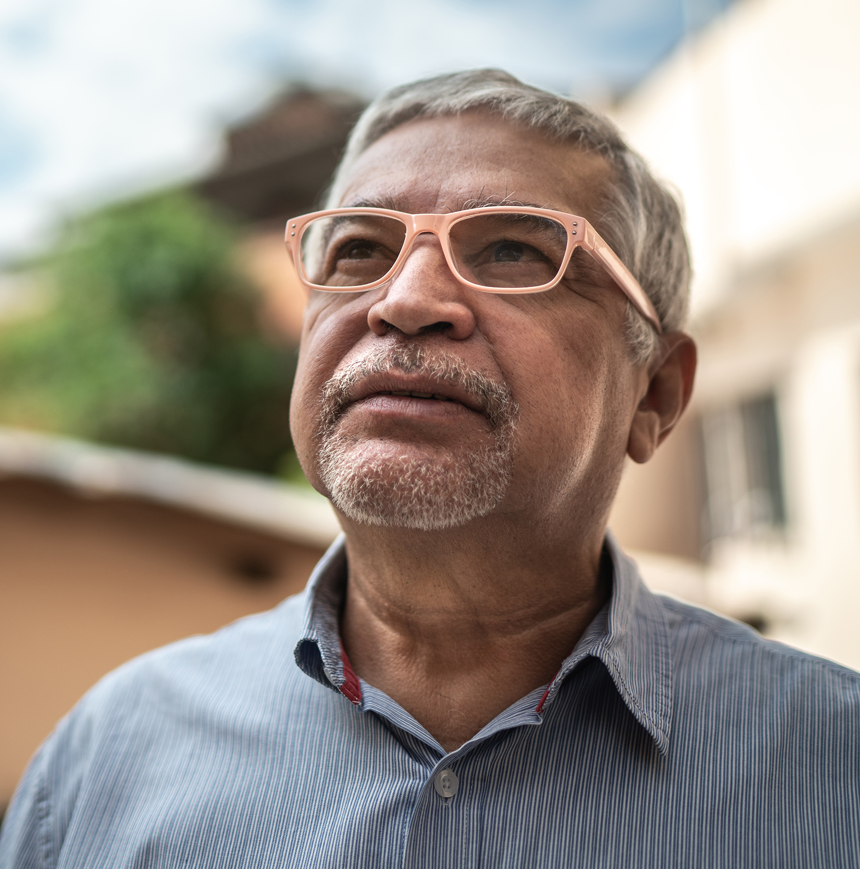
The checking steps have no time limit …
a great time for discussion and research to improve the text
Make changes as needed . . .
. . . praying for God’s guidance

Slide 5
Try it
Check the work translated in last session
Did the checking steps improve the text?
Were there many errors?

Slide 6
?
What happens if you skip steps?

Slide 7


